Slide 1
Audio recording of special education 1ep, evaluation and section 504 meetings
What do teachers need to know?

Slide 2
procedure for guardian to notify district of plan to audio record
Parent/Guardian/18-Year-Old student notifies school team of plan to audio record within 24 hours of the scheduled IDEA or 504 meeting.

Slide 3
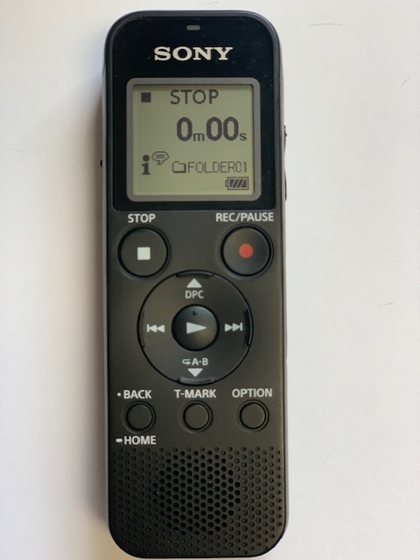
Planning for the meeting
Obtain digital recorder from building department chair, or designated building staff member, assigned to keep the recorder.
Ensure digital recorder is sufficiently charged. Additional AAA batteries can be requested from the Special Services Office (Doreen Grubicy) when needed.
Make sure someone is prepared to read the script at the start of the meeting. This is usually the LEA.

Slide 4
At the meeting – Tips to run an effective & collaborative meeting
Keep positive mindset! Remember all parties at the meeting only want what’s best for the student.
Be confident in your professional abilities. You know your area of content!
Come prepared for the meeting.
Respect the input of all parties and professionally address differences of opinion.
Use parent friendly language and take the time to ensure understanding and opportunity for meaningful parental participation.

Slide 5
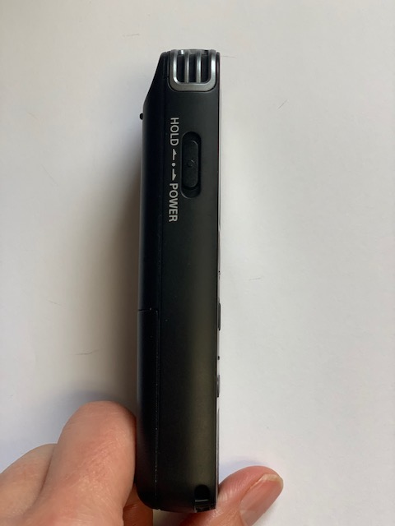
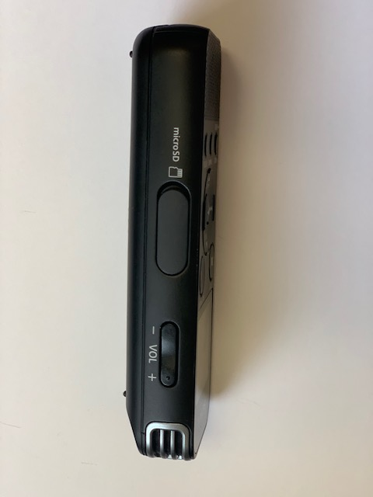
At the meeting – steps to Record & begin meeting
Turn on the recording device by holding down the power switch on side of recorder. (Image 1)
Increase the volume to full power [30] by pressing the top button on the other side of the recorder (Image 2).
Place the recording device in the center of the table (in person) or near the computer (via zoom).
Press the REC/PAUSE button to begin recording (Image 3).
Image 1 Image 2 Image 3

Slide 6
At the meeting – Script to begin Meeting
To begin the meeting, the LEA will read aloud the following script:
Welcome to today’s IEP meeting for [NAME OF CHILD].
Today is [STATE THE DATE AND TIME].
My name is [STATE NAME] and I will be facilitating today’s meeting.
This meeting is being recorded at guardian request.
At this time, I will ask [NAME OF GUARDIAN] to confirm that [he/she/they] has requested that today’s meeting be recorded.
Guardian says yes.
At this time, and as a part of the IEP meeting process, we will introduce today’s meeting participants. We will go around and have each meeting participant state their name and role.
After introductions, begin the meeting as normal.

Slide 7
At the End of meeting – steps to end meeting & Recording
To end the meeting, the LEA (or other staff member) will read aloud the following script (Note: if you forget to read this at the end, it is okay!):
Thank you for attending today’s meeting. This recording will be stored as part of [NAME OF CHILD’S] educational record.
The finalized IEP the team developed today will be provided to you within 20 days.
Turn off the recording device (press STOP) to end recording.

Slide 8
After the meeting – IEP/504 Case Manager or school psych responsibilities:
When the meeting is complete, the case manager/school psychologist will secure the recorder and immediately complete the “Record of Audio Recorded Meeting” document found in SpedTrack Document Library. Upload in SpedTrack to the Attachments Tab (within the IEP/evaluation/504).
Within 24 hours, a building staff member will extract the recording from the recorder and place on thumb drive. A thumb drive was provided to each building along with the recording device. If you need a replacement, please let Doreen Grubicy know.
To extract the recording from the device, slide the USB out from the back of the device. Plug into a computer. A window will automatically open with the recording file. Right click and copy the recording. Right click and paste the recording either in a preferred folder or on your Desktop. You can rename the file to the student’s name, date, and type of meeting. Remove the device from the computer. Plug the thumb drive into the computer. A window will automatically open showing the contents of the thumb drive. Copy and paste the recording file onto the thumb drive. Remove the device from the computer.

Slide 9
After the meeting – IEP/504 or Special education evaluation Case Manager responsibilities – Cont’d:
A building representative will bring the thumb drive & completed “Record of Audio Recorded Meeting” document to the Special Services Office or send it through interoffice mail ATTN: Doreen Grubicy.
Doreen will extract the audio recording and return the thumb drive to the building.
Audio recordings will be kept on a thumb drive in the Special Services Office at Aslin.

Slide 10
Frequently Asked Questions
If the parent/guardian/18-year-old student does not notify a CPS team member they plan to audio record within the 24-hour timeline, will the 504, IEP and/or Special Education Evaluation Meeting be rescheduled?
It depends. The district will make every effort to obtain the technology for the district to record unless the guardian has already been given two written notices of the meeting and Section 504 or IDEA timelines require the meeting to be held.
If the guardian/18-year-old student decides before the meeting not to record, will the district record?
No, the district will only record the meeting if the guardian or 18-year-old student chooses to record.
Can a CPS employee invited to the meeting be excused from attending if they do not want to be audio recorded?
No, given this is adheres to board policy, all staff would be expected to follow this policy.
How should it be handled if there is a reason to discontinue the meeting?
Proceed with discontinuing as you normally would and stop the recording device after all conversations regarding the 504/IEP/Evaluation have concluded. The audio recording will still be maintained as part of the child’s educational record as will the recording from the continuation meeting when the team is reconvened to finalize the document.

Slide 11
FAQ - continued
Can the district choose to record when a parent does not want to record?
No, the meeting would not be recorded.
Will the district record for the parent if the parent does not have a recording device?
Yes, the district will record the meeting for the parent. The district will provide a location for the parent to access/listen to the recording at Aslin.
Will CPS staff be required to listen to the audio recording post meeting?
No, however, the recording will be available for CPS staff on a need-to-know basis.
Can the guardian record other school related meetings such as Parent Teacher Conferences, Discipline Meetings, etc.?
No, unless the purpose of the meeting is a 504, IEP and/or Special Education Meeting, CPS board policy KKB prohibits such recordings.

